Slide 1
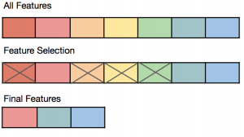
Feature Selection Techniques in Machine Learning
By: Himanshu Shukla
(Data Scientist)

Slide 2
let's first understand some basics of feature selection.
What is Feature Selection?
Need for Feature Selection
Feature Selection Methods/Techniques
Feature Selection statistics
Difference Between Feature Extraction and Feature Selection
Feature selection is a very complicated and vast field of machine learning, and lots of studies are already made to discover the best methods. There is no fixed rule of the best feature selection method. However, choosing the method depend on a machine learning engineer who can combine and innovate approaches to find the best method for a specific problem. One should try a variety of model fits on different subsets of features selected through different statistical Measures.

Slide 3
What is Feature selection
Feature selection is a way of selecting the subset of the most relevant features from the original features set by removing the redundant, irrelevant, or noisy features.
If we input the dataset with all these redundant and irrelevant features, it may negatively impact and reduce the overall performance and accuracy of the model.
Hence it is very important to identify and select the most appropriate features from the data and remove the irrelevant or less important features, which is done with the help of feature selection in machine learning.

Slide 4
Need for feature selection
As we know, in machine learning, it is necessary to provide a pre-processed and good input dataset in order to get better outcomes. We collect a huge amount of data to train our model and help it to learn better. Generally, the dataset consists of noisy data, irrelevant data, and some part of useful data. Moreover, the huge amount of data also slows down the training process of the model, and with noise and irrelevant data, the model may not predict and perform well. So, it is very necessary to remove such noises and less-important data from the dataset and to do this, and Feature selection techniques are used.
Below are some benefits of using feature selection in machine learning:
It helps in avoiding the curse of dimensionality.
It helps in the simplification of the model so that it can be easily interpreted by the researchers.
It reduces the training time.
It reduces over fitting hence enhance the generalization.

Slide 5
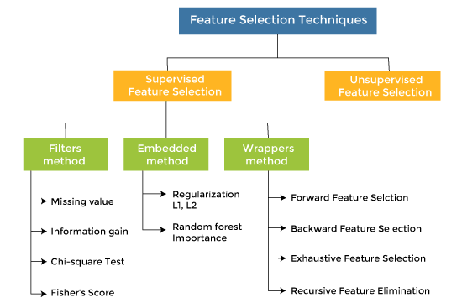
Feature Selection Methods/Techniques

Slide 6
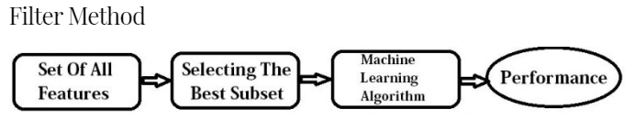
Filter Methods
The filter method filters out the irrelevant feature and redundant columns from the model by using different metrics through ranking.
The filter model only considers the association between the feature and the class label i.e. features are selected on the basis of their scores in various statistical tests for their correlation with the outcome variable.
The advantage of using filter methods is that it needs low computational time and does not over fit the data.
Note: One thing that should be kept in mind is that filter methods do not remove multicollinearity. So, you must deal with multicollinearity of features as well before training models for your data.

Slide 7

You can refer to the following table for defining correlation coefficients for different types of data (in this case continuous and categorical).
Feature(x)\ Response (Y) | Continuous | Categorical
Continuous | Pearson’s Correlation | LDA ( Linear discriminant analysis)
Categorical | Anova | Chi-square
Pearson’s Correlation: It is used as a measure for quantifying linear dependence between two continuous variables X and Y. Its value varies from -1 to +1. Pearson’s correlation is given as:
LDA: Linear discriminant analysis is used to find a linear combination of features that characterizes or separates two or more classes (or levels) of a categorical variable.
ANOVA: ANOVA stands for Analysis of variance. It is similar to LDA except for the fact that it is operated using one or more categorical independent features and one continuous dependent feature. It provides a statistical test of whether the means of several groups are equal or not.
Chi-Square: It is a is a statistical test applied to the groups of categorical features to evaluate the likelihood of correlation or association between them using their frequency distribution.

Slide 8
Some common techniques of Filter methods are as follows:
Information Gain: Information gain determines the reduction in entropy while transforming the dataset. It can be used as a feature selection technique by calculating the information gain of each variable with respect to the target variable.
Correlation with target / Chi-square Test: Chi-square test is a technique to determine the relationship between the categorical variables. The chi-square value is calculated between each feature and the target variable, and the desired number of features with the best chi-square value is selected.
Pairwise Correlations: Many variables are often correlated with each other, and hence are redundant. If two variables are highly correlated, keeping only one will help reduce dimensionality without much loss of information. Which variable to keep ? The one that has a higher correlation coefficient with target.
Fisher's Score: Fisher's score is one of the popular supervised technique of features selection. It returns the rank of the variable on the fisher's criteria in descending order. Then we can select the variables with a large fisher's score.
variance thresholding: The variance of a feature determines how much predictive power it contains. The lower the variance is, the less information contained in the feature, and the less value it has in predicting the response variable. Given this fact, variance thresholding is done by finding the variance of each feature, and then dropping all of the features below a certain variance threshold. This threshold could be 0 if you only want to remove features that have the same value for each instance of the response variable. However, to remove more features from your dataset, the threshold could be set to 0.5, 0.3, 0.1, or another value that makes sense for the distribution of variances.
Variance Inflation Factor (VIF) : is a measure of the amount of multicollinearity in a set of multiple regression variables. Mathematically, the VIF for a regression model variable is equal to the ratio of the overall model variance to the variance of a model that includes only that single independent variable. This ratio is calculated for each independent variable. A high VIF indicates that the associated independent variable is highly collinear with the other variables in the model.
Percent Missing Values / Missing Value Ratio: The value of the missing value ratio can be used for evaluating the feature set against the threshold value. The formula for obtaining the missing value ratio is the number of missing values in each column divided by the total number of observations. The variable is having more than the threshold value can be dropped.
Missing Value Ratio = (No. of Missing values * 100) / Total No. of Observation

Slide 9
Variance Threshold :
Basically used for Dropping Constant Features
Variance Threshold is a feature selector that removes all the low variance features from the dataset that are of no great use in modeling. It looks only at the features (x), not the desired outputs (y), and can thus be used for unsupervised learning. Default Value of Threshold is 0.
Use Sklearn’s Variance Threshold.
If Variance Threshold = 0 (Remove Constant Features )
If Variance Threshold > 0 (Remove Quasi-Constant Features )

Slide 10
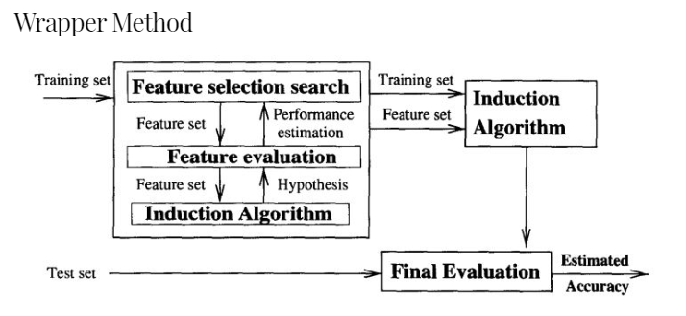
Wrapper methods
In wrapper methods, we try to use a subset of features and train a model using them. Based on the inferences that we draw from the previous model, we decide to add or remove features from your subset.
Wrapping methods compute models with a certain subset of features and evaluate the importance of each feature. Then they iterate and try a different subset of features until the optimal subset is reached.
Three drawbacks of this method are:
These methods are usually computationally very expensive.
the large computation time for data with many features.
it tends to over fit the model when there is not a large amount of data points.

Slide 11
Some techniques of wrapper methods
Forward Selection: Forward selection is an iterative method in which we start with having no feature in the model. In each iteration, we keep adding the feature which best improves our model till an addition of a new variable does not improve the performance of the model.
Backward Elimination: In backward elimination, we start with all the features and removes the least significant feature at each iteration which improves the performance of the model. We repeat this until no improvement is observed on removal of features.
Exhaustive Feature Selection- Exhaustive feature selection is one of the best feature selection methods, which evaluates each feature set as brute-force. It means this method tries & make each possible combination of features and return the best performing feature set.
Recursive Feature elimination: It is a greedy optimization algorithm which aims to find the best performing feature subset. It repeatedly creates models and keeps aside the best or the worst performing feature at each iteration. It constructs the next model with the left features until all the features are exhausted. It then ranks the features based on the order of their elimination.

Slide 12
Difference between Filter and Wrapper methods
The main differences between the filter and wrapper methods for feature selection are:
Filter methods measure the relevance of features by their correlation with dependent variable while wrapper methods measure the usefulness of a subset of feature by actually training a model on it.
Filter methods are much faster compared to wrapper methods as they do not involve training the models. On the other hand, wrapper methods are computationally very expensive as well.
Filter methods use statistical methods for evaluation of a subset of features while wrapper methods use cross validation.
Filter methods might fail to find the best subset of features in many occasions but wrapper methods can always provide the best subset of features.
Using the subset of features from the wrapper methods make the model more prone to overfitting as compared to using subset of features from the filter methods.

Slide 13
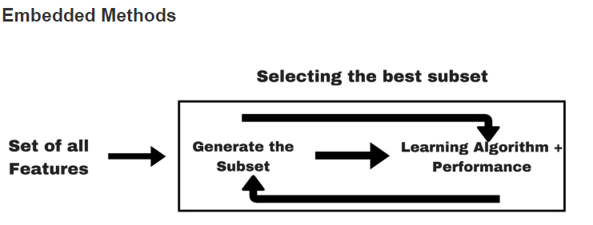
Embedded methods
Embedded methods combined the advantages of both filter and wrapper methods by considering the interaction of features along with low computational cost. These are fast processing methods similar to the filter method but more accurate than the filter method.
In embedded method, the features are selected in the training process of learning model, and the feature selection result outputs automatically while the training process is finished. Training the Lasso regression model is a classic example of embedded method for feature selection.
Embedded methods are iterative in a sense that takes care of each iteration of the model training process and carefully extract those features which contribute the most to the training for a particular iteration. Regularization methods are the most commonly used embedded methods which penalize a feature given a coefficient threshold.
This is why Regularization methods are also called penalization methods that introduce additional constraints into the optimization of a predictive algorithm (such as a regression algorithm) that bias the model toward lower complexity (fewer coefficients).
According to the evaluation criterion, feature selection methods can be derived from correlation, Euclidean distance, consistency, dependence and information measures.
According to the type of output, feature selection methods can be divided into feature rank (weighting) and subset selection models.

Slide 14
Some techniques of embedded methods are:
Regularization- Regularization adds a penalty term to different parameters of the machine learning model for avoiding overfitting in the model. This penalty term is added to the coefficients; hence it shrinks some coefficients to zero. Those features with zero coefficients can be removed from the dataset. The types of regularization techniques are L1 Regularization (Lasso Regularization) , Ridge regression and Elastic Nets (L1 and L2 regularization).
Random Forest Importance - Different tree-based methods of feature selection help us with feature importance to provide a way of selecting features. Here, feature importance specifies which feature has more importance in model building or has a great impact on the target variable. Random Forest is such a tree-based method, which is a type of bagging algorithm that aggregates a different number of decision trees. It automatically ranks the nodes by their performance or decrease in the impurity (Gini impurity) over all the trees. Nodes are arranged as per the impurity values, and thus it allows to pruning of trees below a specific node. The remaining nodes create a subset of the most important features.

Slide 15
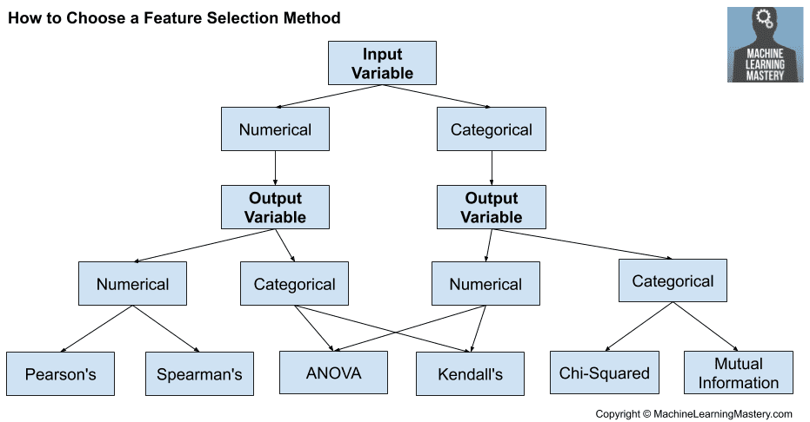

Slide 16
When to use Feature Selection & Feature Extraction
The key difference between feature selection and feature extraction techniques used for dimensionality reduction is that while the original features are maintained in the case of feature selection algorithms, the feature extraction algorithms transform the data onto a new feature space.
Feature selection techniques can be used if the requirement is to maintain the original features, unlike the feature extraction techniques which derive useful information from data to construct a new feature subspace. Feature selection techniques are used when model explainability is a key requirement.
Feature extraction techniques can be used to improve the predictive performance of the models, especially, in the case of algorithms that don’t support regularization.
Unlike feature selection, feature extraction usually needs to transform the original data to features with strong pattern recognition ability, where the original data can be regarded as features with weak recognition ability.

Slide 17
Feature Extraction Concepts & Techniques
Feature extraction is about extracting/deriving information from the original features set to create a new features subspace. The primary idea behind feature extraction is to compress the data with the goal of maintaining most of the relevant information. As with feature selection techniques, these techniques are also used for reducing the number of features from the original features set to reduce model complexity, model overfitting, enhance model computation efficiency and reduce generalization error. The following are different types of feature extraction techniques:
Principal component analysis (PCA) for unsupervised data compression. Here is a detailed post on feature extraction using PCA with Python example. You will get a good understanding of how PCA can help with finding the directions of maximum variance in high-dimensional data and projects the data onto a new subspace with equal or fewer dimensions than the original one. This is explained with example of identifying Taj Mahal (7th wonder of world) from top view or side view based on dimensions in which there is maximum variance. The diagram below shows the dimensions of maximum variance (PCA1 and PCA2) as a result of PCA.
Linear discriminant analysis (LDA) as a supervised dimensionality reduction technique for maximizing class separability
Nonlinear dimensionality reduction via kernel principal component analysis (KPCA)

Slide 18
The END
THANKS!
Any questions?
You can find me at:
Himanshu.shukla.him@gmail.com

